Slide 1
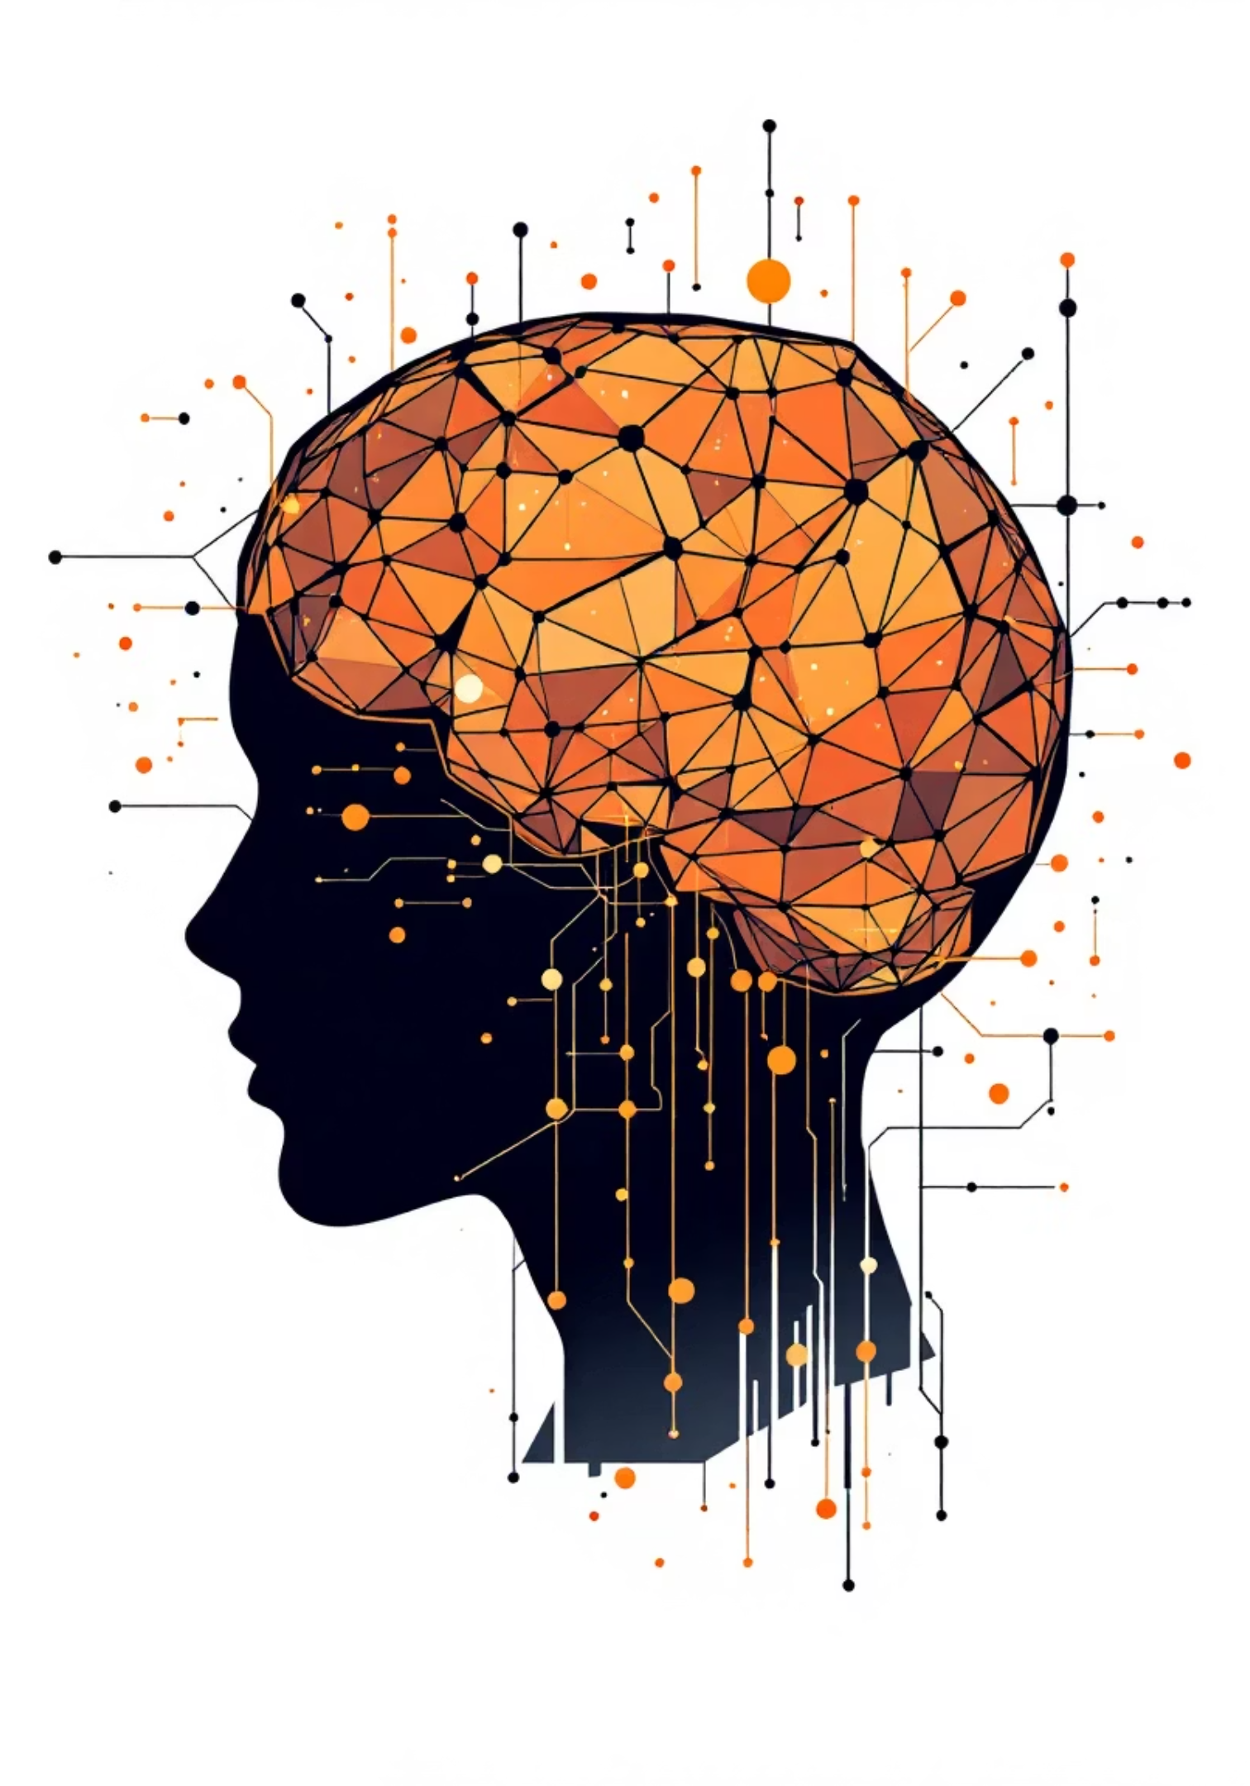
ExplainX – Universal Multimodal Content Explainer
A Retrieval-Augmented AI System for Web, Video & Media Understanding

Slide 2


Problem: The Multimodal Content Gap
Information is pervasive, spanning various digital formats, yet current AI tools fall short in comprehensive understanding.
Fragmented Information
Critical insights are scattered across videos, websites, images, PDFs, and audio.
Text-Centric Limitations
Existing explainers, like Google NotebookLM, are predominantly text-based, ignoring rich visual context.
Shallow Video Analysis
Video understanding is often limited to mere transcripts, lacking deep visual or frame-level reasoning.
No Unified Retrieval
A significant gap exists in unified multimodal retrieval, preventing holistic content comprehension.

Slide 3

Introducing ExplainX: True Multimodal Understanding
ExplainX is a next-generation universal content explainer, designed to bridge the multimodal gap.
Holistic Content Ingestion
ExplainX accepts any web link, transcending text-only limitations to understand:
Text content from articles and documents
Speech from audio and video
Images and embedded visuals
Full-motion video streams
Knowledge Integration
All extracted knowledge is systematically stored and organized within a powerful vector database.
Intelligent Q&A
Leveraging a sophisticated Retrieval-Augmented Generation (RAG) pipeline, ExplainX provides accurate, context-rich answers to user queries.

Slide 4
Key Capabilities of ExplainX
ExplainX offers a suite of advanced features for comprehensive content analysis.
Universal Link Acceptance
Deep Website Reading
Advanced Video Analysis
Process content from any link: websites, videos, PDFs, or standalone images.
Understands text, images, and embedded video content within webpages.
Analyzes video content using both audio transcripts and visual frames.
Integrated OCR
YOLO Object Detection
Semantic Vector Search
Extracts text from images and individual video frames, capturing on-screen information.
Utilizes YOLO for precise object and scene detection within visual media.
Enables intelligent search through content using vector embeddings for relevance.
Source-Grounded Answers
Provides highly accurate responses, firmly grounded in the original source material.

Slide 5
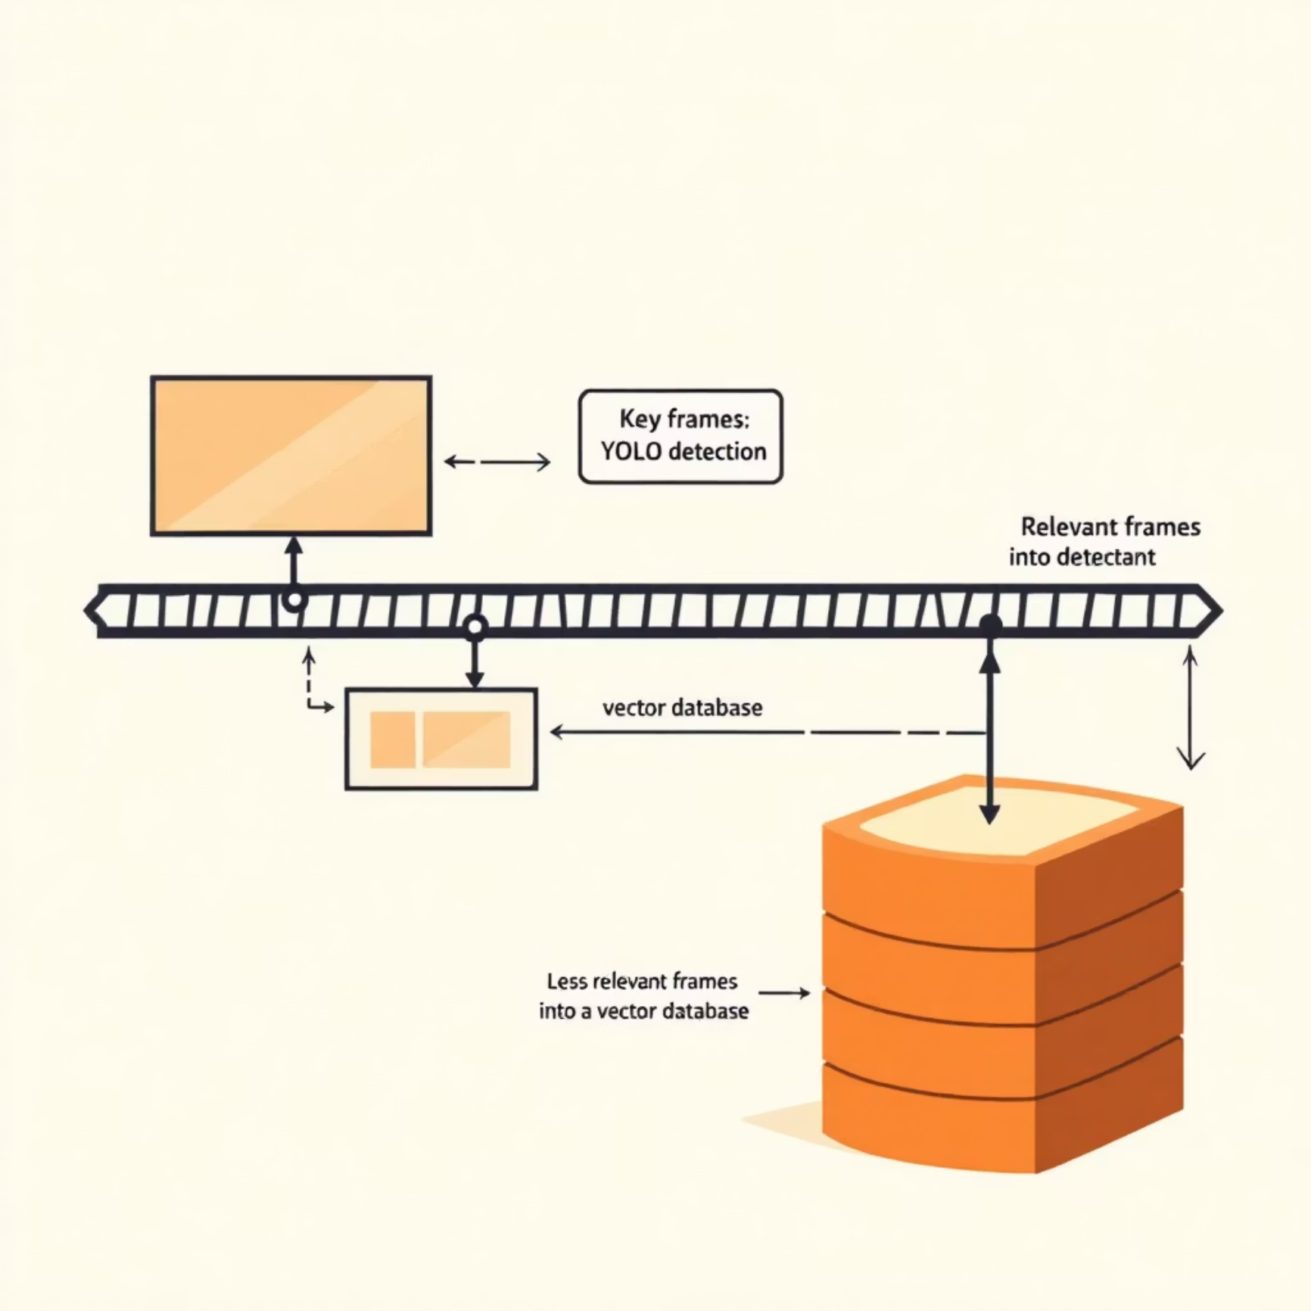

Unique Innovation: Intelligent Frame Scoring
ExplainX redefines video understanding by moving beyond mere transcripts.
Beyond Transcripts
Instead of treating videos as flat audio transcripts, ExplainX extracts and visually analyzes individual frames.
Visual Context Extraction
YOLO: Detects crucial objects, scenes, and actions within video frames.
OCR: Extracts all visible text from frames, capturing on-screen information.
Relevance Scoring
Each frame undergoes a sophisticated scoring process to determine its information density and relevance.
Optimized Storage
Only high-information frames—those rich in visual or textual context—are stored in the vector database, ensuring efficiency and accuracy.
This intelligent frame-scoring approach clearly differentiates ExplainX from existing tools like Google NotebookLM.

Slide 6

Multimodal Ingestion Pipeline
A streamlined process to transform diverse web content into actionable knowledge.
User Link
Link Type
Content Extract
Unified JSON
This systematic ingestion ensures that all forms of content are processed and prepared for retrieval and analysis, providing a comprehensive input for the RAG system.

Slide 7
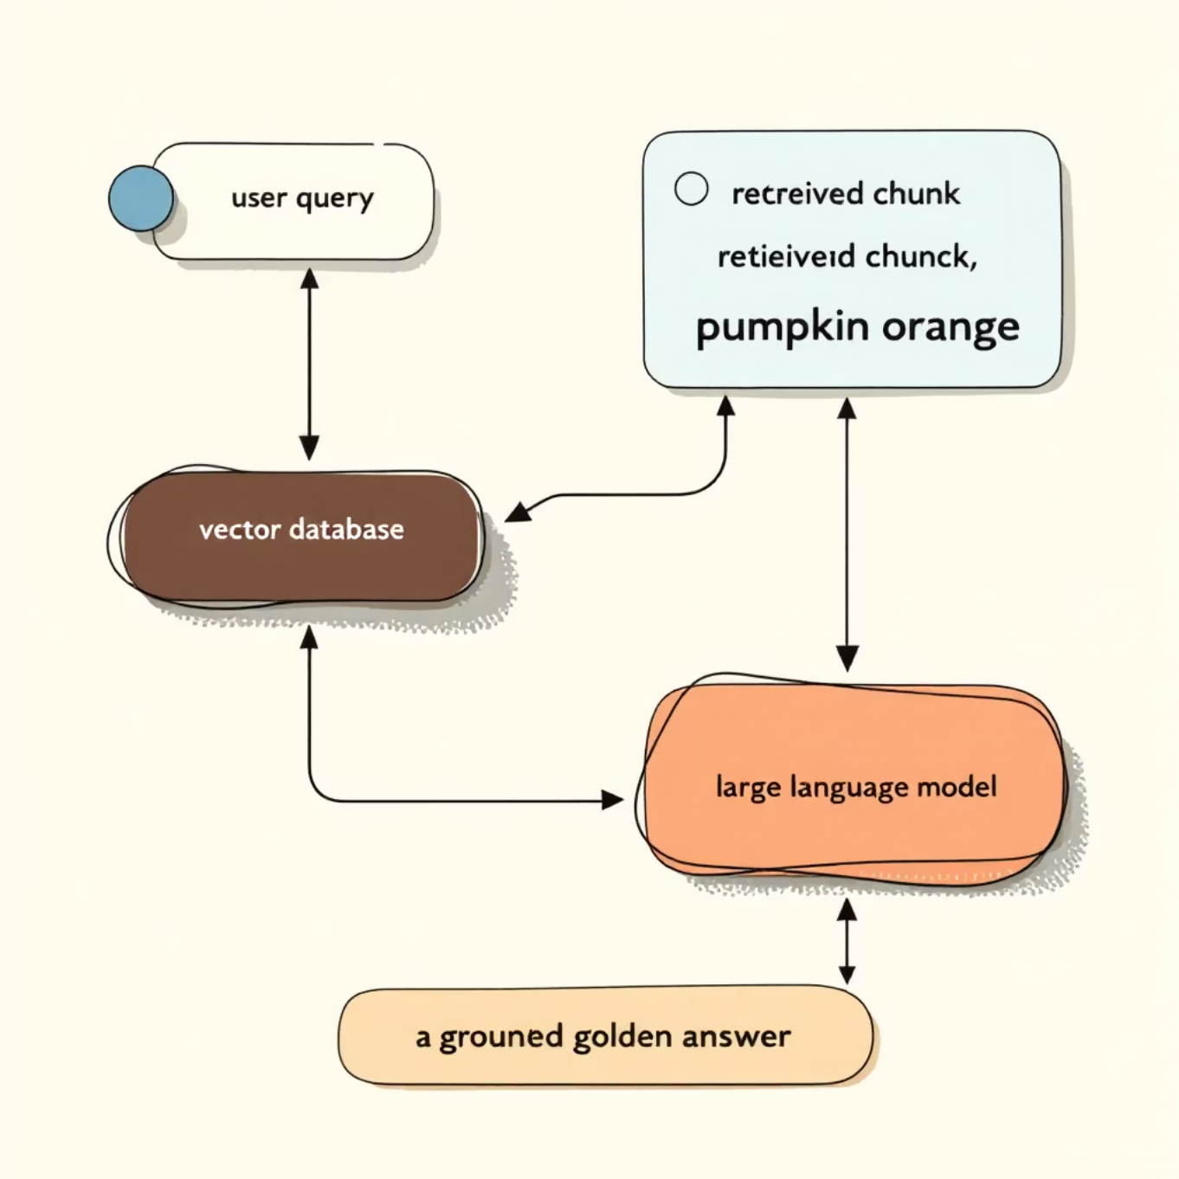

ExplainX: The Core RAG Architecture
Our Retrieval-Augmented Generation (RAG) pipeline ensures accurate, context-grounded responses.
1. User Query Embedding
The user's question is converted into a vector embedding, representing its semantic meaning.
2. Vector Database Retrieval
The embedded query is used to retrieve the top-K most relevant content chunks from our comprehensive vector database.
3. Diverse Data Inclusion
Retrieved data can include a rich array of multimodal information:
Website text and articles
Video transcripts for spoken context
OCR text from images and video frames
Visual object context from YOLO analysis
4. LLM-Powered Response Generation
A Large Language Model (LLM) generates an answer, strictly adhering to the retrieved data.
This critical step prevents hallucinations and guarantees that every response is directly supported by the original content sources.

Slide 8

Technology Stack Powering ExplainX
A robust and modern technology stack ensures scalability, efficiency, and cutting-edge AI capabilities.
Backend & Orchestration
1
Python: The core programming language
FastAPI: High-performance web framework for APIs
AI / Machine Learning
2
Faster Whisper: Efficient Speech-to-Text transcription
YOLO: Real-time object detection for visual analysis
OCR: Optical Character Recognition for text extraction
LLMs: Large Language Models for advanced reasoning and generation
Data Management
3
Vector Database: Chroma / FAISS / Langbase for semantic indexing
Embedding Models: State-of-the-art models for creating vector representations

Slide 9
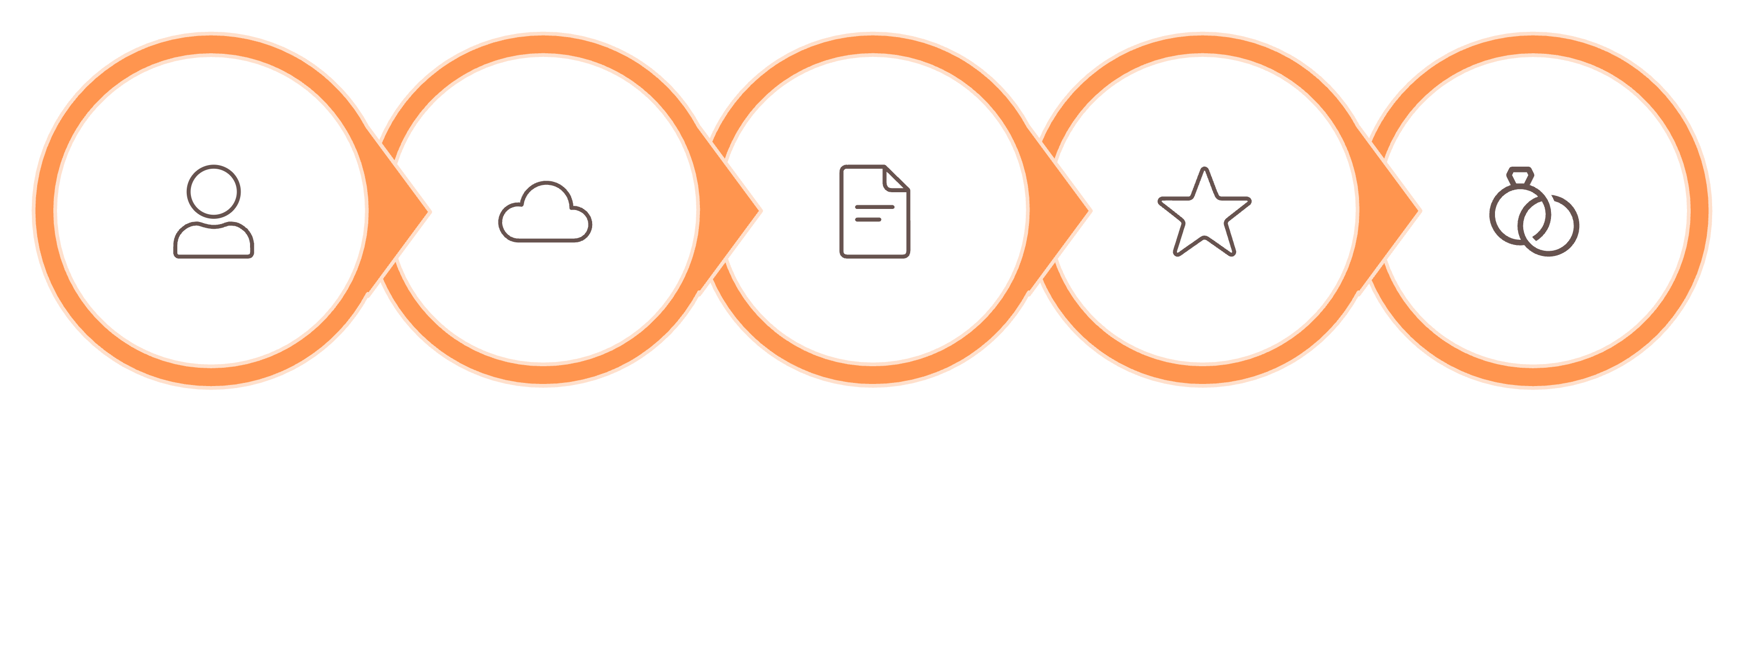
ExplainX: End-to-End System Flow
From user input to an intelligent answer, witness the seamless journey of content processing.
Multimodal Extraction
Frame Scoring
Vector Embedding
User
Upload Link
This comprehensive pipeline ensures that every piece of information is meticulously processed, analyzed, and leveraged to provide the most accurate and contextually relevant responses.

Slide 10

Advantages, Use Cases & Conclusion
Key Advantages
True Multimodal Understanding: Processes web, video, image, and audio like never before.
Frame-Aware Video Explanations: Deep visual context from intelligently scored frames.
Dynamic Website Capability: Works seamlessly across complex and interactive websites.
Scalable RAG Architecture: Built for efficiency and future extensibility.
Transformative Use Cases
Education: Enhance learning with deep explanations of multimedia content.
Research: Accelerate information gathering and analysis from diverse sources.
Technical Documentation: Instantly grasp complex concepts across formats.
Media Analysis: Extract granular insights from video and image content.
Conclusion: ExplainX is a next-generation multimodal RAG system that understands content the way humans do.

